Slide 1
Data Stuctures and Algorithms
Dr. Fidaa Abed

Slide 2
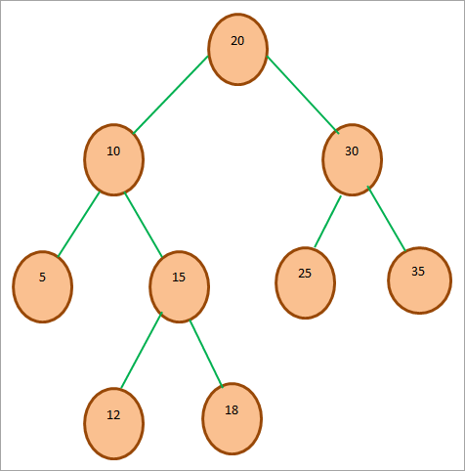
Binary Search Tree
Binary Search tree
Binary tree
The value in root is greater than in left part
The value in root is less than in right part
This applies for all subtrees

Slide 3
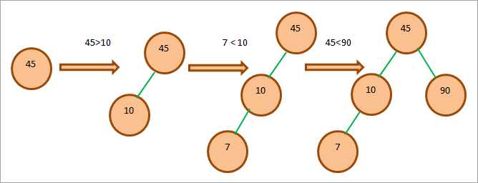
Creating a Binary Search Tree
Given array: 45, 10, 7, 90, 12, 50, 13, 39, 57

Slide 4
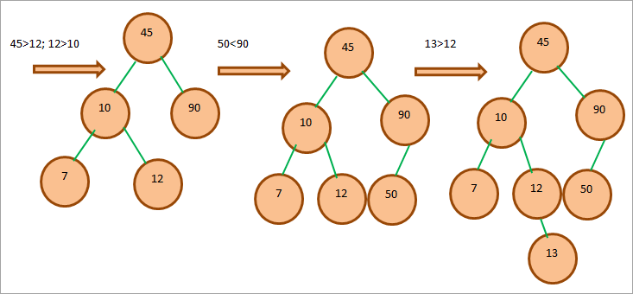
Creating a Binary Search Tree
Given array: 45, 10, 7, 90, 12, 50, 13, 39, 57

Slide 5
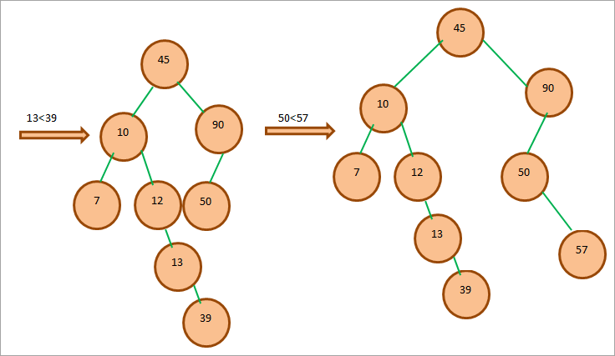
Creating a Binary Search Tree
Given array: 45, 10, 7, 90, 12, 50, 13, 39, 57

Slide 6
Creating a Binary Search Tree
Given array: 45, 10, 7, 90, 12, 50, 13, 39, 57

Slide 7
Insert Element
Start from the root.
Compare the element to be inserted with the root node. If it is less than root, then traverse the left subtree or traverse the right subtree.
Traverse the subtree till the end of the desired subtree. Insert the node in the appropriate subtree as a leaf node.

Slide 8
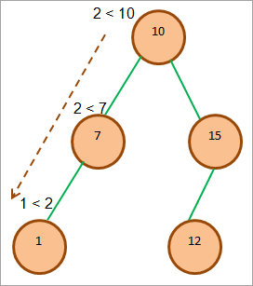
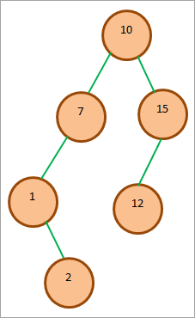
Insert Element
Insert 2

Slide 9
Search for Element
Compare the element to be searched with the root node.
If the key (element to be searched) = root, return root node.
Else if key < root, traverse the left subtree.
Else traverse right subtree.
Repetitively compare subtree elements until the key is found or the end of the tree is reached.

Slide 10
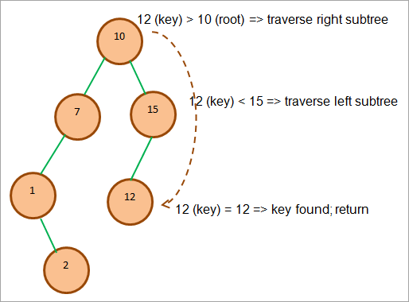
Search for Element
Search for 12

Slide 11
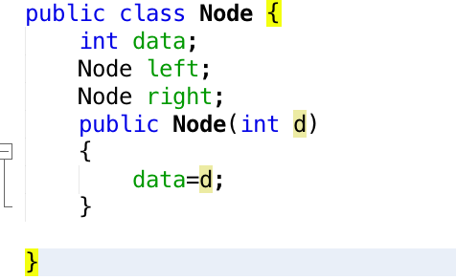
Node Class

Slide 12

BST Class

Slide 13
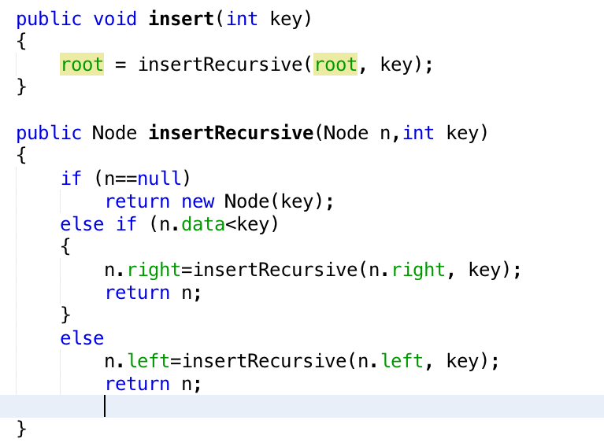
Insert

Slide 14
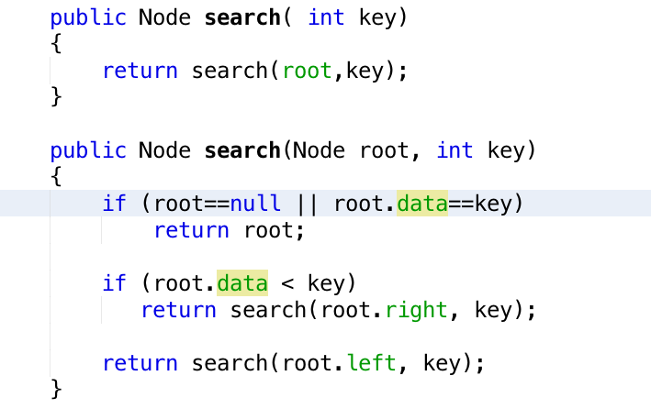
Search

Slide 15
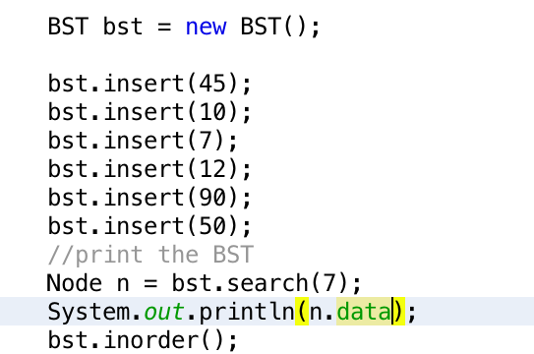

Test

Slide 16
Excercises
Implement Binary Search Tree
Test this tree by inserting numbers 5,10,20,13,15,27
Print the tree using inorder traversal
Write a method to find the maximum value in the binary search tree

